Slide 1
Android advanced UI

Slide 2
Table of contents
LayoutInflater and Dynamic Layout
AdapterView

Slide 3
2 way to use Layout
Declare UI elements in XML: Android provides a straightforward XML vocabulary that corresponds to the View classes and subclasses.
Instantiate layout elements at runtime: Your app can create View and ViewGroup objects (and manipulate their properties) programmatically.

Slide 4
LayoutInflater
When Instantiate layout elements at runtime, LayoutInflater is what you need
No more explaination, just go to the codes and examples

Slide 5
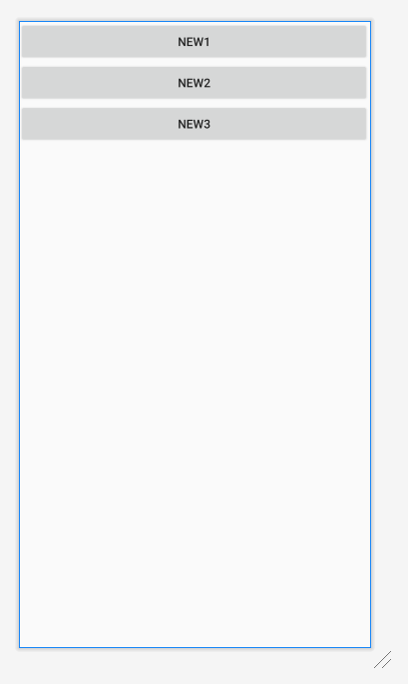
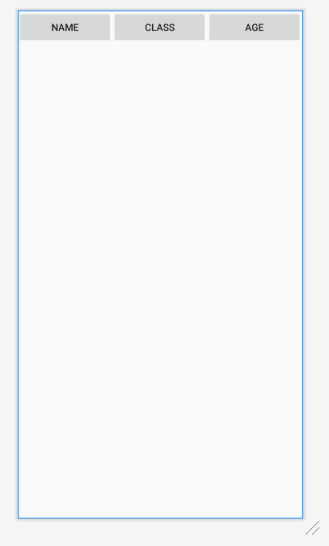
layout_person_info
layout_dynamic

Slide 6
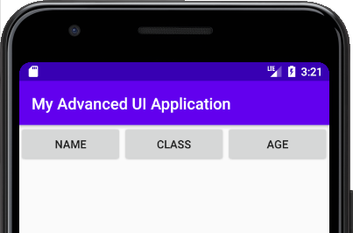
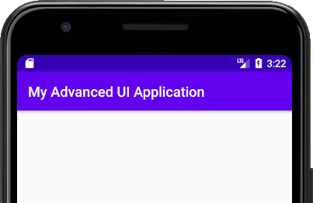
Condition 1
@Override protected void onCreate(Bundle savedInstanceState) { super.onCreate(savedInstanceState); setContentView(R.layout.layout_person_info); }
@Override protected void onCreate(Bundle savedInstanceState) { super.onCreate(savedInstanceState); }

Slide 7
Condition 2
@Override protected void onCreate(Bundle savedInstanceState) { super.onCreate(savedInstanceState); LayoutInflater inflater = LayoutInflater.from(this); LinearLayout linearLayout = (LinearLayout)inflater.inflate(R.layout.layout_person_info, null, false); setContentView(linearLayout); }

Slide 8
Condition 2

Slide 9
Condition 3
@Override protected void onCreate(Bundle savedInstanceState) { super.onCreate(savedInstanceState); LayoutInflater inflater = LayoutInflater.from(this); LinearLayout linearLayout = (LinearLayout)inflater.inflate(R.layout.layout_person_info, null, false);
Button button = new Button(this); button.setText("Dynamic Btn"); linearLayout.addView(button); setContentView(linearLayout); }

Slide 10
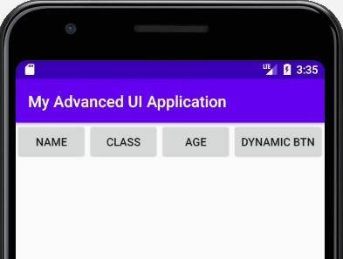
Condition 3

Slide 11
Condition 4
@Override protected void onCreate(Bundle savedInstanceState) { super.onCreate(savedInstanceState); LayoutInflater inflater = LayoutInflater.from(this); LinearLayout linearLayout = (LinearLayout)inflater.inflate(R.layout.layout_person_info, null, false);
LinearLayout linearLayout2 = (LinearLayout)inflater.inflate(R.layout.layout_dynamic, null, false); linearLayout.addView(linearLayout2);
setContentView(linearLayout); }

Slide 12
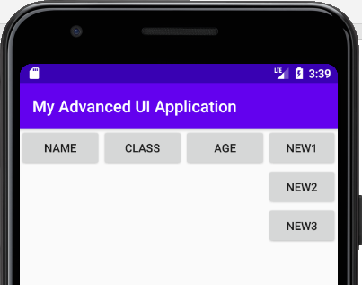
Condition 4

Slide 13
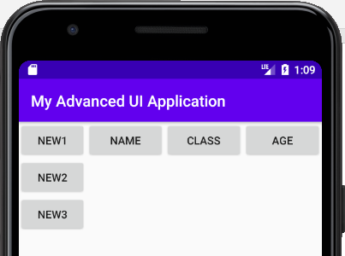
Condition 5
linearLayout.addView(linearLayout2,0);

Slide 14
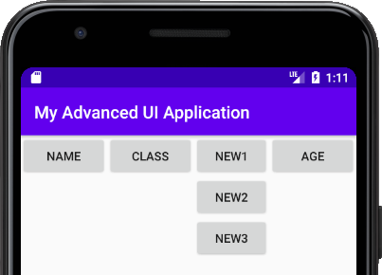
Condition 6
linearLayout.addView(linearLayout2,2);

Slide 15
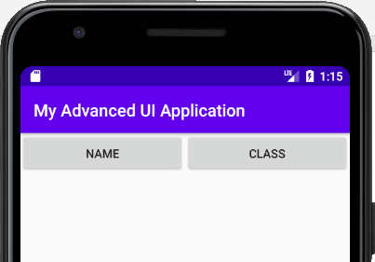
Condition 7
linearLayout.removeViewAt(2);

Slide 16
Question: what does inflater do?
Inflate a layout?

Slide 17
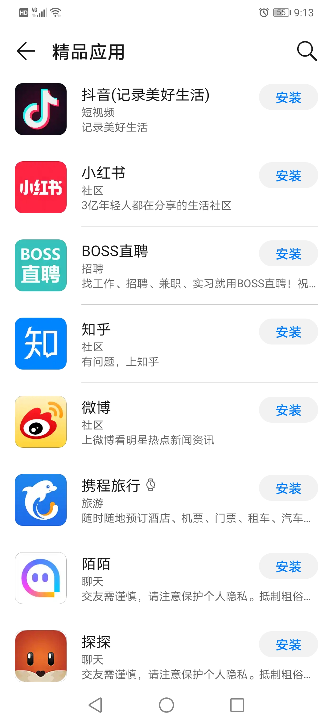
The number of items to be displayed is changing with time, how to display correctly?

Slide 18
AdapterView may do the work
AdapterView is a ViewGroup that displays items in an adapter which comes from an array-based data source.
Type of AdapterView:
Spinner
ListView
RecycleView
GridView

Slide 19
Spinner
Create res/values/arrays.xml
<<?xml version="1.0" encoding="utf-8"?> <resources> <string-array name="colors"> <item>"a"</item> <item>"b"</item> <item>"c"</item> <item>"1"</item> <item>"2"</item> <item>"3"</item> </string-array> </resources>

Slide 20
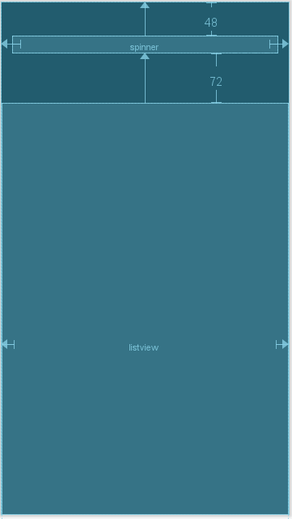

Slide 21
Spinner
// in onCreate()
Spinner s1 = (Spinner) findViewById(R.id.spinner);
ArrayAdapter adapter = ArrayAdapter.createFromResource( this, R.array.colors, android.R.layout.simple_spinner_item);
adapter.setDropDownViewResource(android.R.layout.simple_spinner_dropdown_item);
s1.setAdapter(adapter);

Slide 22
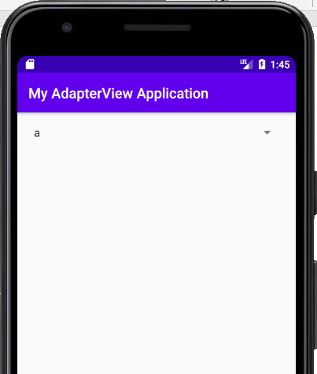
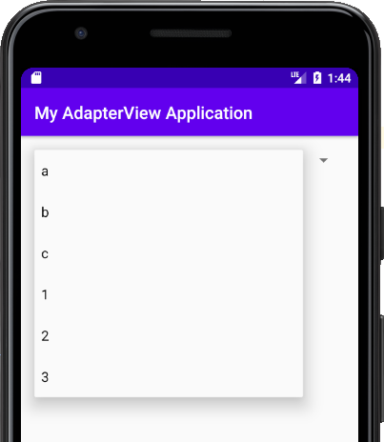
Spinner

Slide 23
ListView
ListView listView = (ListView)findViewById(R.id.listview);
ArrayAdapter adapter1 = ArrayAdapter.createFromResource( this, R.array.colors, android.R.layout.simple_list_item_1);
listView.setAdapter(adapter1);

Slide 24
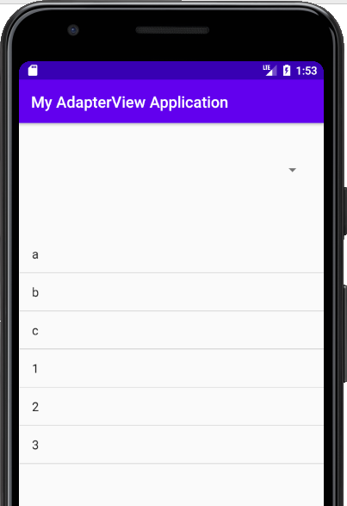
ListView

Slide 25
ListView OnItemClickListener
listView.setOnItemClickListener(new AdapterView.OnItemClickListener()
{ @Override public void onItemClick(AdapterView adapterView, View view, int i, long l) { // Display a messagebox. Toast.makeText(getApplicationContext(), ""+i+","+l+","+ adapterView.getAdapter().getItem(i),Toast.LENGTH_SHORT).show(); } });

Slide 26
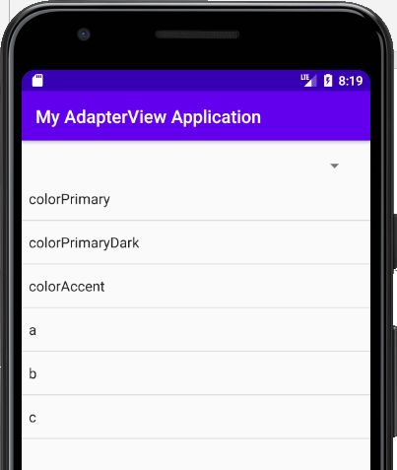
Data relationship
d1
Adapter
d2
binding
binding
d3
…
dn
change the underlying data that is read by your Adapter, you should call notifyDataSetChanged().

Slide 27
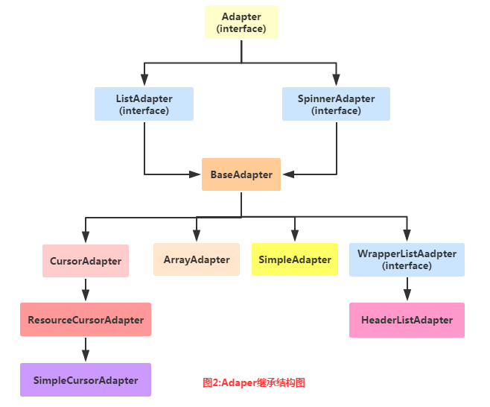
Types of Adapter

Slide 28
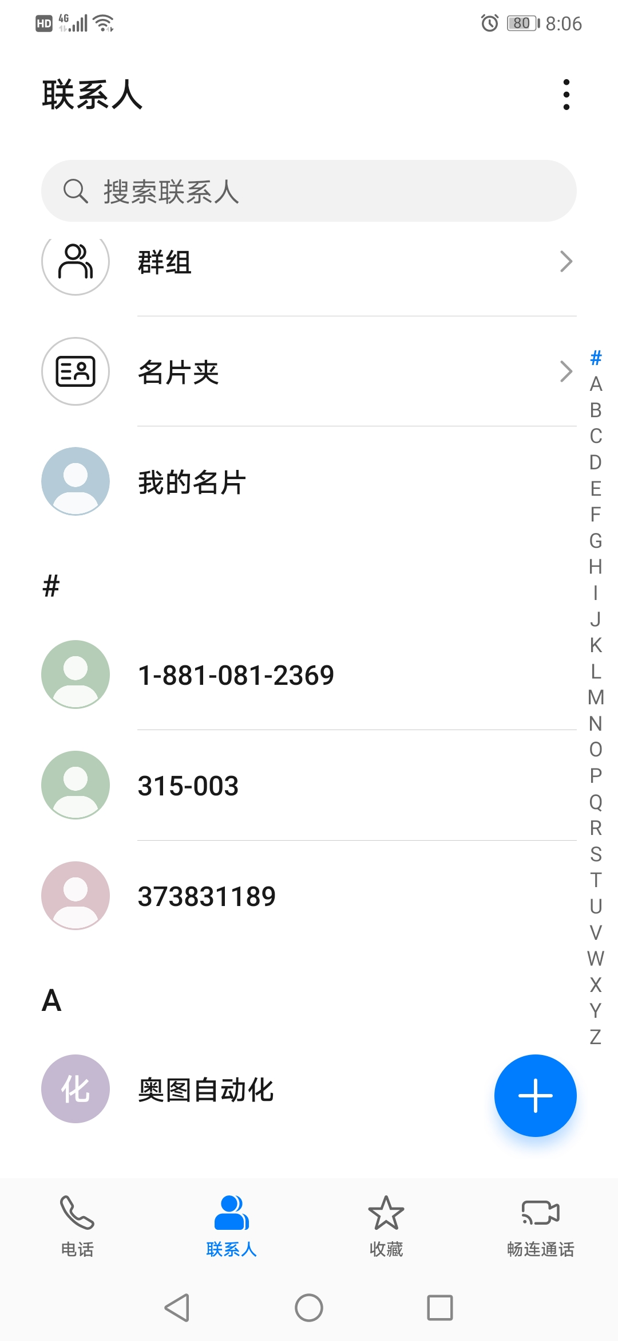
HomeWork 5: Address book
功能要求
增删改查，查询支持模糊查询
人员信息：姓名，电话号码，邮箱
录入信息有效性验证
界面要求
搜索功能和联系人列表在同一屏幕
其他方面不作具体要求，可参考各自喜欢的界面
提交时间：2020-12-01

